Slide 1
Occupational Specialist Component Content: Digital Production, Design and Development
The T Level T Level Technical Qualification in Digital: Digital Production, Design and Development includes a single Occupational Specialist Component. Therefore, there is a single synoptic assessment for the Occupational Specialist Component, which is an extended ‘design, development and implementation’ project. The synoptic element of the project is important in order to ensure that students are able to demonstrate threshold competence: this is the principal reason why the Occupational Specialism is assessed via a single extended project assessment to ensure that students are able to evidence all the skills required by the Performance Outcomes.
The T Level Technical Qualification in Digital: Digital Production, Design and Development Occupational Specialist Component consists of several activities grouped into four substantive tasks.
Each task will be completed during a window set by Pearson during which you will schedule supervised assessment sessions. In some cases, tasks will also involve opportunities for unsupervised activities where the requirements of the skills being assessed make this necessary.

Slide 2
Learning Objectives
Aims:
To identify and manage risks that apply to software development
Objectives:
To be able to assess the potential risks associated with a developing a software product appropriate to the context and market environment in which it is being developed
To be able to make and justify software development decisions and recommendations based on effective assessment of risk vs reward in relation to the context and market environment in which they are developing software

Slide 3
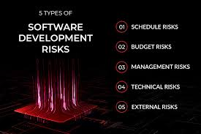
Risk in Software Development
Risk management in software development involves identifying, evaluating, and addressing threats that may affect the successful delivery of a product.
Why It Matters:
Effective risk management increases the chances of delivering a secure, high-quality product on time and within budget.
Notes:
https://codeit.us/blog/software-development-risks

Slide 4
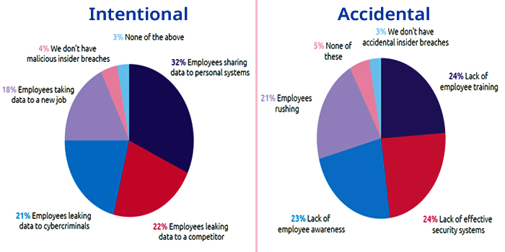
Data and System Security
Protecting sensitive information and maintaining system integrity is critical to user trust and regulatory compliance.
Why It Matters: Breaches can cause data loss, financial damage, or legal penalties.
Common Risks:
Hacking and malware attacks
Accidental data exposure
Unencrypted data transfer
Mitigation Strategies:
Use encryption and secure authentication
Regular security audits
Train staff on cybersecurity protocols
Notes:
https://www.stealthlabs.com/blog/infographic-20-alarming-insider-threats-statistics/

Slide 5
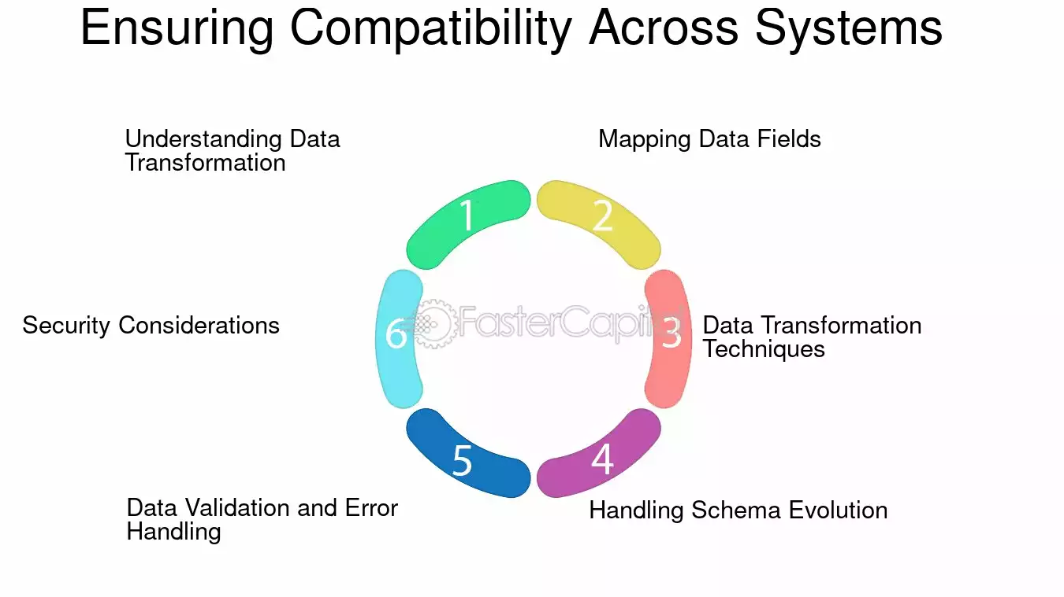
Compatibility with Other Systems
Software often needs to work with other tools, operating systems, or legacy infrastructure.
Why It Matters: Incompatibility can lead to failures, reduced efficiency, and poor user experience.
Common Risks:
Missing deadlines
Underestimating project scope
Skipping code reviews
Mitigation Strategies:
Use Agile/Scrum to improve delivery
Break work into manageable sprints
Buffer time for unexpected issues
Notes:
https://fastercapital.com/topics/ensuring-compatibility-across-different-systems.html/1

Slide 6
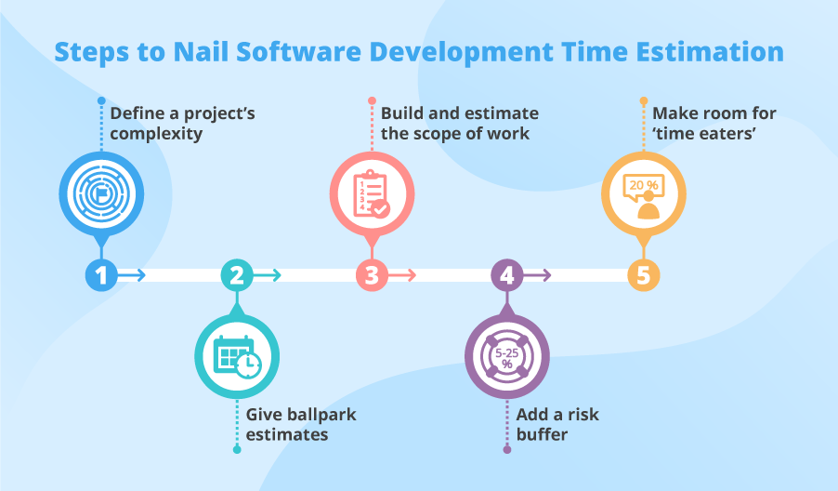
Development Time Constraints
Fast development cycles can pressure teams to cut corners, impacting quality.
Why It Matters: Rushing can result in overlooked bugs, design flaws, or incomplete features.
Common Risks:
Missing deadlines
Underestimating project scope
Skipping code reviews
Mitigation Strategies:
Use Agile/Scrum to improve delivery
Break work into manageable sprints
Buffer time for unexpected issues
Notes:
https://www.scnsoft.com/software-development/software-development-time

Slide 7
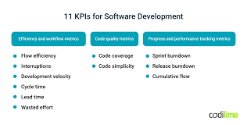
Requirements and KPIs Compliance
Software must fulfil both user-defined requirements and performance goals.
Why It Matters: Missing either type leads to dissatisfaction or system failure.
Common Risks:
Features not matching user stories
Poor response time or uptime
Lack of accessibility
Mitigation Strategies:
Use a requirements traceability matrix
Monitor KPIs throughout the SDLC
Conduct acceptance testing
Notes:
https://codilime.com/blog/software-development-kpi/

Slide 8
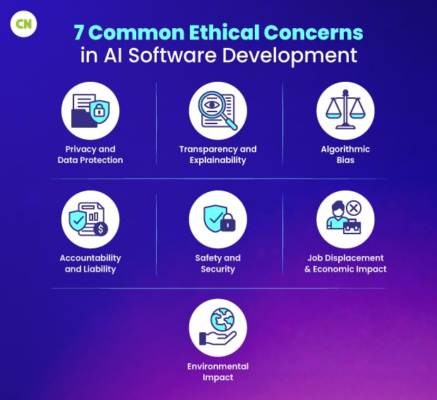
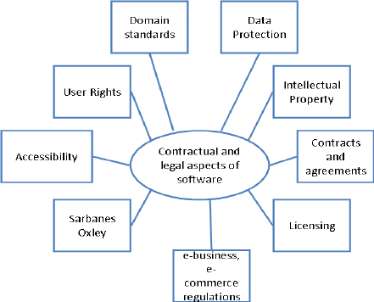
Legal and Ethical Risk Areas
Software must comply with legal standards and avoid unethical behaviour, especially around user data.
Why It Matters: Non-compliance can lead to lawsuits, fines, or user backlash.
Common Risks:
Breach of data protection laws
Intellectual property violations
Algorithmic bias
Mitigation Strategies:
Comply with GDPR, CCPA, etc.
Conduct ethical reviews and audits
Use open-source responsibly
Notes:
https://www.capitalnumbers.com/blog/ai-software-development-ethical-considerations/
https://www.lawdonut.co.uk/business/blog/24/01/ten-legal-issues-software-development
https://x-team.com/magazine/ethical-issues-in-software-development

Slide 9

User Engagement Risks
Low engagement can cause a product to fail regardless of technical success
Why It Matters: Engaged users drive feedback, retention, and growth.
Common Risks:
Unintuitive interfaces
Lack of personalization
No clear onboarding
Mitigation Strategies:
Involve users early via feedback loops
Perform usability testing
Provide training and documentation
Notes:
https://eluminoustechnologies.com/blog/software-development-risks/

Slide 10
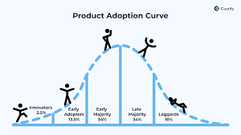
Product Reach and Market Adoption
A great product may still fail if it doesn’t reach the right market or is blocked in some regions.
Why It Matters: Understanding the audience and environment is essential.
Common Risks:
Poor marketing strategy
Territorial content restrictions
Inaccessible language or culture
Mitigation Strategies:
Research target markets
Implement localization
Use multiple distribution channels
Notes:
https://www.custify.com/blog/product-adoption-guide/

Slide 11
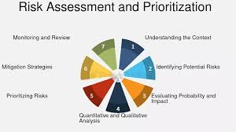
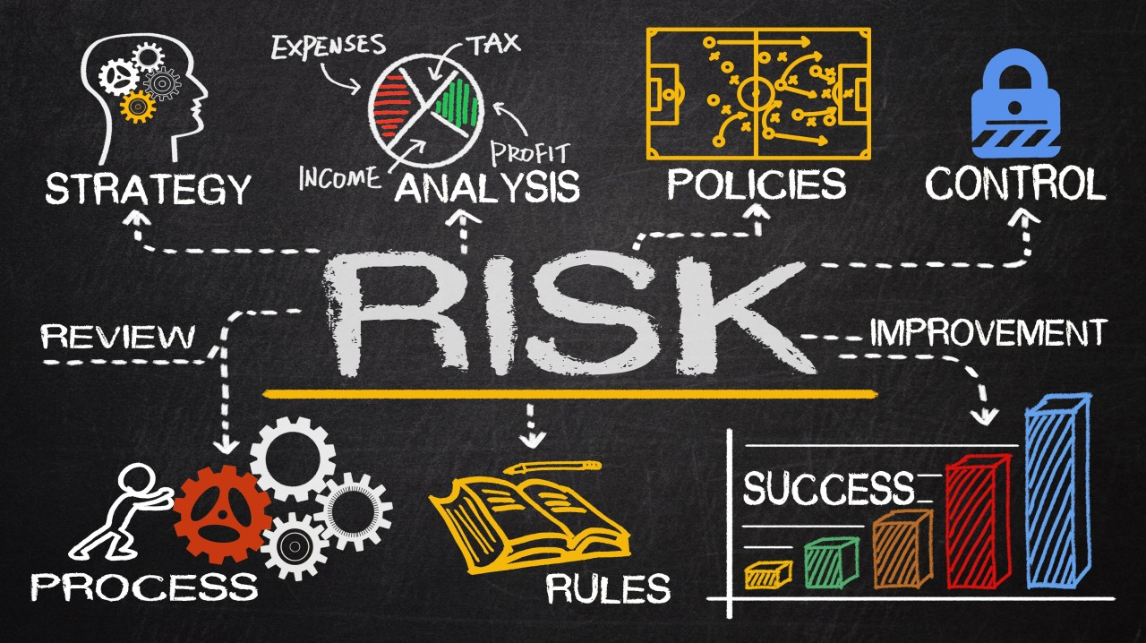
Assessing and Prioritizing Risk
All risks are not equal; some are more likely or more damaging than others.
Why It Matters: Helps allocate time and resources effectively.
Common Risks:
Frequent but low-impact bugs
Rare but critical outages
Security gaps
Mitigation Strategies:
Use risk matrices (likelihood vs impact)
Update risk logs regularly
Engage stakeholders in prioritization
Notes:
https://fastercapital.com/topics/risk-assessment-and-prioritization.html/1
https://www.linkedin.com/pulse/prioritizing-risk-management-fast-paced-software-strategies-mahar-cjdxf/

Slide 12
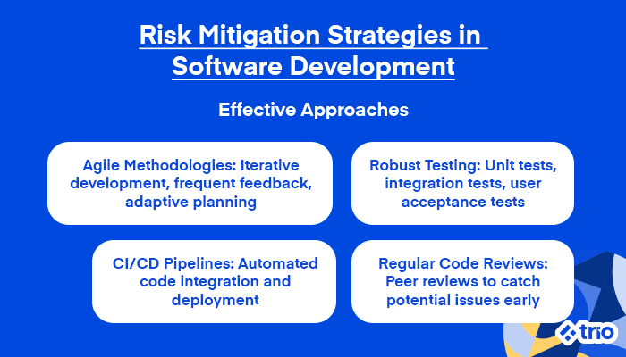
Impact, Mitigation and Monitoring
Understanding the potential fallout of each risk guides proper response planning.
Why It Matters: Constant monitoring ensures early detection and resolution.
Common Risks:
Loss of customer data
Downtime during peak usage
Failure to recover from attack
Mitigation Strategies:
Create incident response plans
Use logging and alert systems
Review risks after each sprint
Notes:
https://trio.dev/risk-management-in-software-development/

Slide 13
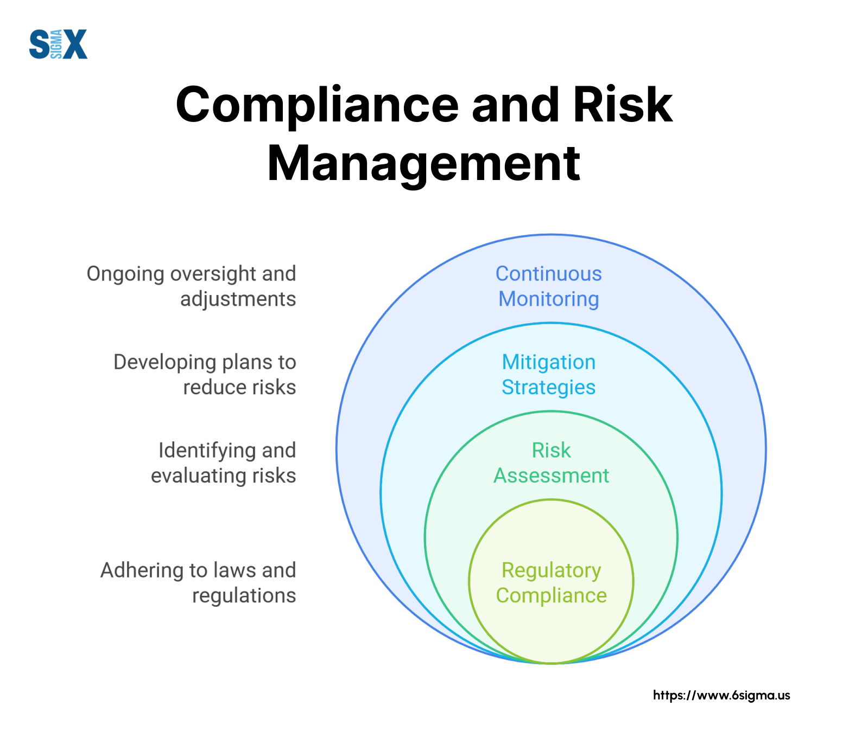
Policies and Procedures for Risk Control
Having documented procedures standardizes response and prevents chaos during emergencies.
Why It Matters: Protects organizational data, staff, and continuity.
Common Risks:
Inconsistent backup schedules
Lack of recovery procedures
No user role management
Mitigation Strategies:
Create clear backup & restore protocols
Define access and security roles
Train team on policies
Notes:
https://www.6sigma.us/project-management/compliance-and-risk-management/
Backups: Automated, frequent, off-site
Security: Password policy, encryption, penetration testing
CIA Principles: Ensure Confidentiality, Integrity, Availability
Personnel & Training: Cybersecurity awareness, secure coding
Business Continuity: Work-from-home readiness, vendor fallback
Disaster Recovery: Restore procedures, failover systems

Slide 14
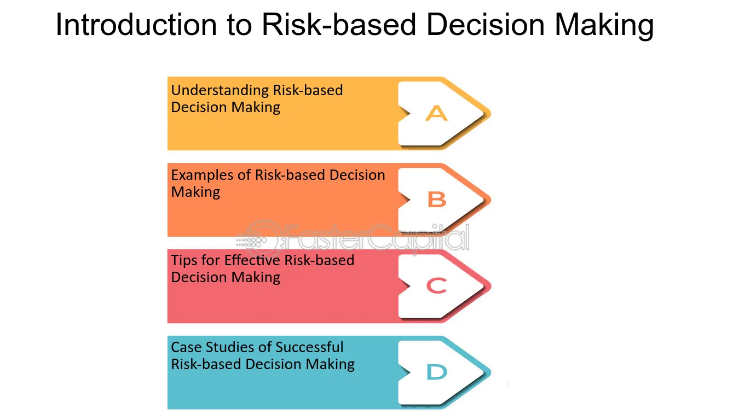
Risk-Based Decision Making
Decision-making must consider both risk and potential reward.
Why It Matters: Supports choosing the best option in uncertain scenarios.
Common Risks:
Launching without full test coverage
Choosing speed over security
Selecting new unproven tech
Mitigation Strategies:
Perform cost-benefit analysis
Document assumptions and risk levels
Justify trade-offs based on goals
Notes:
https://fastercapital.com/content/Risk-based-decision-making--Informed-Decisions--Harnessing-the-Power-of-Risk-Based-Decision-Making-in-Risk-Management.html

Slide 15
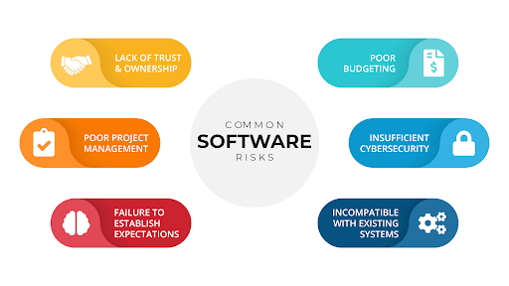
Activity - Identifying and Managing Software Development Risks
Objective:
Work in your teams to investigate and analyse key risks in software development and develop strategies to manage or mitigate those risks.
Team assignments
Each team member will take responsibility for a different category of risk assessment and planning.
Technical Risks
Business and Legal Risks
Operational and User Risks
Tasks
Research and identify at least 2–3 risks in each category assigned to your group.
Assess the likelihood and potential impact of each risk (low, medium, high).
Propose mitigation strategies or policies to reduce or manage these risks.
Create a short risk register or visual summary to present to the class.
Deliverables:
Identify and assess 2–3 risks per area
Evaluate risk likelihood and impact
Propose realistic mitigation strategies
Present a visual risk summary or register to the class
Notes:
Time: 45–60 mins (research + 5–7 min presentation)

